Slide 1
The statistical significance of an insight is typically assessed by conducting a hypothesis test. Choose a level of significance (alpha) for the test. This is the probability of making a Type I error, which is rejecting the null hypothesis when it is actually true. The most common level of significance is 0.05. Choose an appropriate test statistic and calculate its value from the sample data. Determine the p-value, which is the probability of obtaining a test statistic as extreme or more extreme than the observed value, assuming the null hypothesis is true.
significance in Statistics

Slide 2
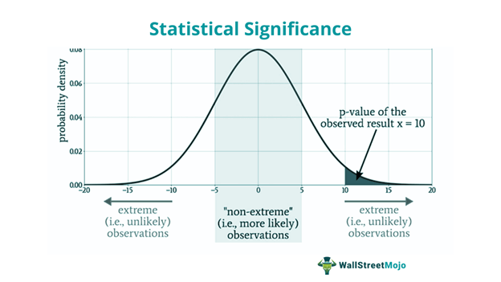

Slide 3
Mean
In statistics, the mean (also known as the average) is a measure of central tendency that represents the sum of a set of numerical values divided by the number of values in the set. For example, if we have the following set of numbers: 2, 4, 6, 8, and 10, the mean can be calculated as follows:
Mean = (2 + 4 + 6 + 8 + 10) / 5 = 30 / 5 = 6
Therefore, the mean of the set of numbers is 6. This value is often used to represent the typical value of a dataset and is a useful tool for analyzing and comparing different sets of data.

Slide 4
The meaning of standard deviation
The standard (or σ) deviation measures the spread of the data about the mean value. It is useful in comparing sets of data which may have the same mean but a different range. For example, the mean of the following two is the same: 15, 15, 15, 14, 16 and 2, 7, 14, 22, 30.
A standard deviation (or σ) is a measure of how dispersed the data is in relation to the mean. Low standard deviation means data are clustered around the mean, and high standard deviation indicates data are more spread out.
Calculate the mean of the squared differences: Mean of Squared Differences = (289 + 144 + 49 + 4 + 1 + 9 + 25 + 64 + 169 + 324) / 10 = 104.6
Take the square root of the mean of the squared differences: Standard Deviation = √(104.6) = 10.2

Slide 5
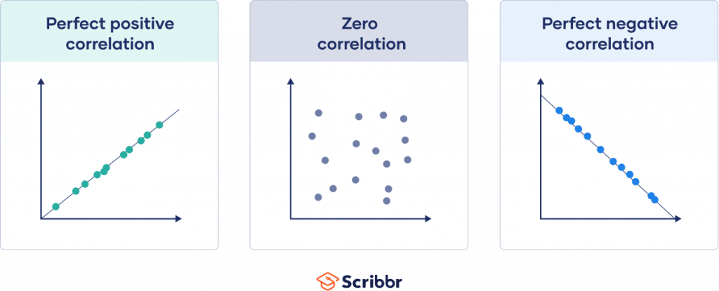
Correlation
Correlation is a statistical measure that indicates the extent to which two or more variables fluctuate in relation to each other.
A correlation between variables, however, does not automatically mean that the change in one variable is the cause of the change in the values of the other variable.

Slide 6
Note: 1= Correlation does not imply causation.
Positive Linear Correlation. There is a positive linear correlation when the variable on the x -axis increases as the variable on the y -axis increases. ...
Negative Linear Correlation. ...
Non-linear Correlation (known as curvilinear correlation) ...
No Correlation.

Slide 7
Meaning of covariance
Covariance is a measure of the relationship between two random variables and to what extent, they change together. Or we can say, in other words, it defines the changes between the two variables, such that change in one variable is equal to change in another variable.
To calculate covariance, you can use the formula:
Cov(X, Y) = Σ(Xi-µ)(Yj-v) / n
6,911.45 + 25.95 + 1,180.85 + 28.35 + 906.95 + 9,837.45 = 18,891.
Cov(X, Y) = 18,891 / 6.

Slide 8
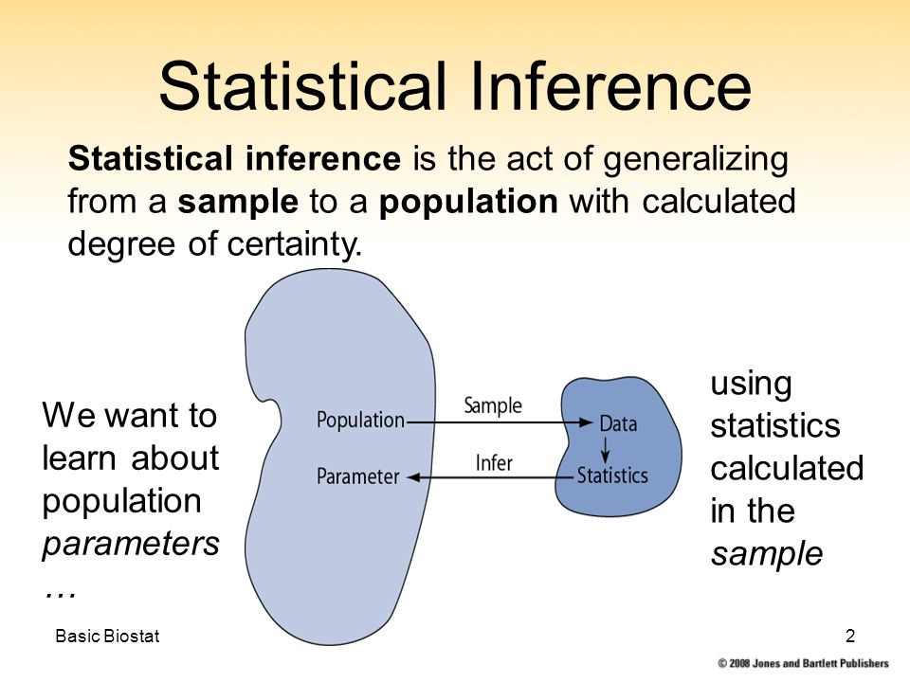
Inferential statistics
Inferential statistics are often used to compare the differences between the treatment groups. Inferential statistics use measurements from the sample of subjects in the experiment to compare the treatment groups and make generalizations about the larger population of subjects.

Slide 9
Sample t - test
The one-sample t-test is a statistical hypothesis test used to determine whether an unknown population mean is different from a specific value.
The one-sample t-test is used when we want to know whether our sample comes from a particular population but we do not have full population information available to us. For instance, we may want to know if a particular sample of college students is similar to or different from college students in general.
T = (X̄ – μ) / S/√n

Slide 10
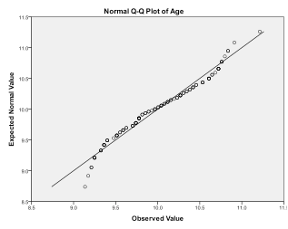
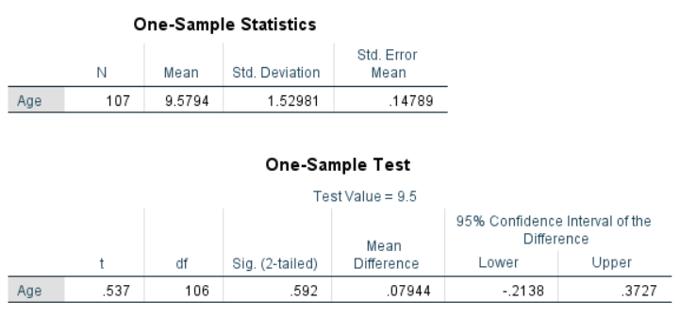

Slide 11
The relationship between standard deviation and standard variance
The Standard Deviation is a measure of how spread out numbers are. The formula is easy: it is the square root of the Variance.
Unlike range and interquartile range, variance is a measure of dispersion that takes into account the spread of all data points in a data set. It's the measure of dispersion the most often used, along with the standard deviation, which is simply the square root of the variance.
Variance is the square of standard deviation.
Variance is the average squared deviations from the mean, while standard deviation is the square root of this number.

Slide 12
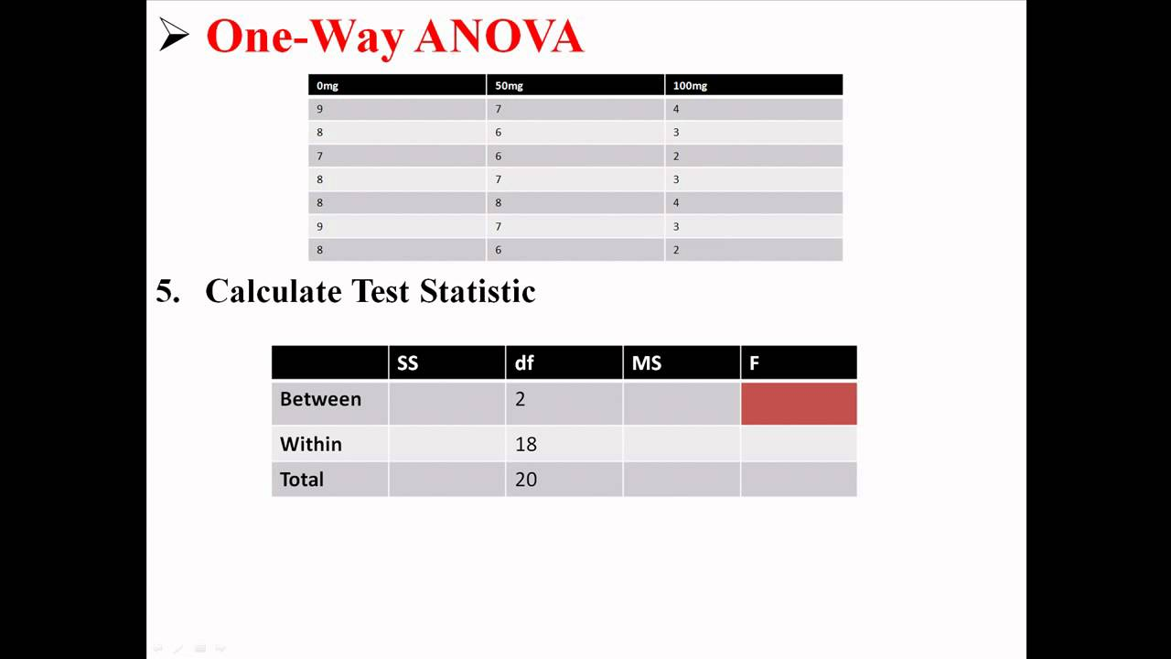
One way Anova test
One-way ANOVA is typically used when you have a single independent variable, or factor, and your goal is to investigate if variations, or different levels of that factor have a measurable effect on a dependent variable.
The one-way ANOVA formula: F-statistics or F-ratio: F = MSB/MSW.

